Slide 1
Operationalizing ML Model with Azure Databricks
Manjunath Suryanarayana
Solutions Architect– Big Data & Advanced Analytics
masuryan@microsoft.com

Slide 2
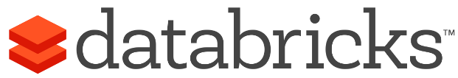
Azure Databricks
Databricks is the team which started the Spark project at UC Berkeley in 2009, the goad was to make big data simple and building a Unified Analytics Platform.
Azure Databricks is a first party service on Azure.
Unlike with other clouds, it is not an Azure Marketplace or a 3rd party hosted service.
Azure Databricks is integrated seamlessly with Azure services:
Eliminates need to create a separate account with Databricks.
Microsoft Azure

Slide 3
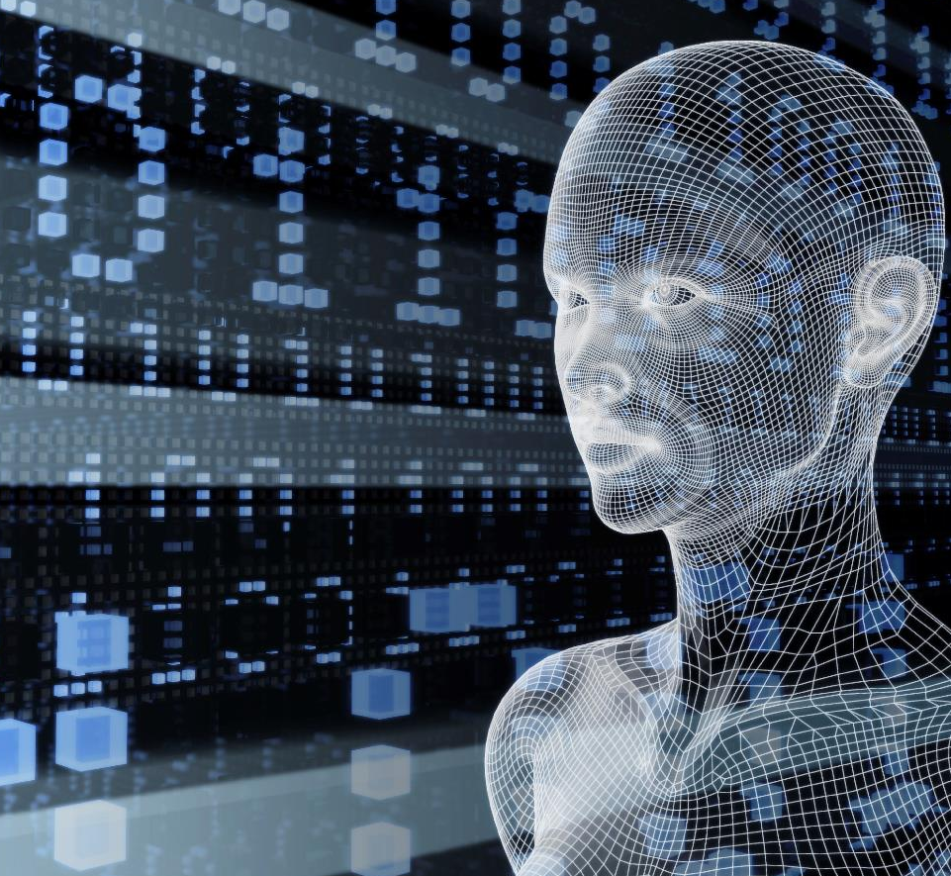

About Me
Solution Architect at Microsoft
Big Data | Machine Learning | AI | Cloud
Around 18+ Years of Experience
Microsoft | IQVIA | Aditi Technologies | Dell | Mindtree
Manjunath Suryanarayana
Product Dev, Services and Sales teams
Engineering| Operations & Management Technology| Leadership | Solution Selling, Pre-Sales
MSc. Information Technology
Microsoft Cloud Certified| Microsoft Big Data Certified | Microsoft Data Science Certified
Contact Me
https://www.linkedin.com/in/manjj/
masuryan@microsoft.com

Slide 4
Agenda
Azure Databricks at high level
Spark Mllib 2.x
Serializing a Model
Model Scoring – Requirements to Architectures (Best Practices)
Azure Databricks Model Scoring

Slide 5



Azure Databricks
Azure Databricks
Collaborative Workspace
IoT / streaming data
Machine learning models
DATA ENGINEER
DATA SCIENTIST
BUSINESS ANALYST
Deploy Production Jobs & Workflows
Cloud storage
BI tools
MULTI-STAGE PIPELINES
JOB SCHEDULER
NOTIFICATION & LOGS
Data warehouses
Optimized Databricks Runtime Engine
Data exports
Hadoop storage
DATABRICKS I/O
APACHE SPARK
SERVERLESS
Rest APIs
Data warehouses
Enhance Productivity
Build on secure & trusted cloud
Scale without limits
Notes:
Databricks, founded by the team that created Apache Spark – unified analytics platform that accelerates innovation by unifying data science, engineering & business.
75% of the code committed to Apache Spark comes from Databricks
Unified Runtime
Create clusters in seconds, dynamically scale them up and down.
They’ve made enhancements to Spark engine to make it 10x faster than open source Spark
Serverless- Auto-configured multi-user cluster, Reliable sharing with fault isolation
Unified Collaboration
Overall – a simple & collaborative environment that enables your entire team to use Spark & interact with your data simultaneously
DE – Improve ETL performance, zero management clusters. Execute production code from within notebooks
DS - For data scientists, easy data exploration in notebooks
Business SME – interactive dashboards empower teams to create dynamic reports
Enterprise Security
Encryption
Fine grained Role-based access control (files, clusters, code, application, dashboard)
Compliance
Rest APIs
DE – DBIO, SPARK, API’s , JOBS
DS – Spark and Serverless, Interactive Data Science
Data Products - Everything
Creators of Spark
Training People
Number of Customers
Ingest
Workflow
Schedule / Run / Monitor
Execute
Troubleshoot
Debug
Production Jobs
---------
Ingest, ETL, Scheduling, Monitoring

Slide 6

Apache Spark
An unified, open source, parallel, data processing framework for Big Data Analytics
Spark SQL
Interactive Queries
Spark MLlib
Machine Learning
Spark Streaming
Stream processing
GraphX
Graph Computation
Spark Unifies:
Batch Processing
Interactive SQL
Real-time processing
Machine Learning
Deep Learning
Graph Processing
Spark Core Engine
Yarn
Mesos
Standalone Scheduler
Spark MLlib
Machine Learning
Spark Structured Streaming
Stream processing

Slide 7
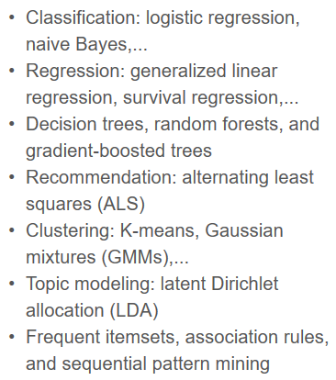
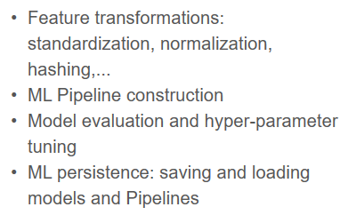
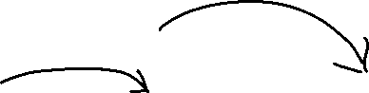
Apache Spark MLlib
Scalable Machine Learning Library
Distributed algorithms that scale linearly with data
Algorithms cover most of the use cases, includes
Machine Learning workflow utilities
Migration to Spark Dataframe started with 1.3
Contribution by 75+ orgs
Built around the concept of Pipeline (Scikit – Learn)
Agile Modeling Process
Spark Structured Streaming
Stream processing

Slide 8
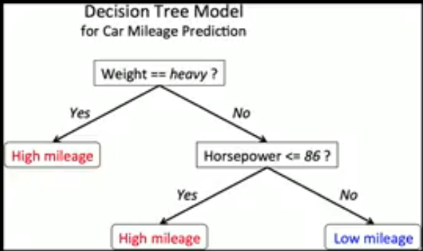
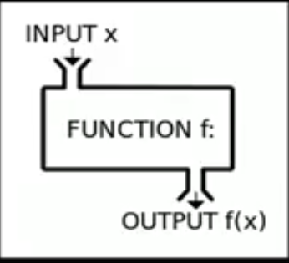
Machine Learning Model
The process of training an ML model involves providing an ML algorithm (that is, the learning algorithm) with training data to learn from. The term ML model refers to the model artifact that is created by the training process.
A Model is a Mathematical Function f(x)
Eg. Linear Regression
Y = b0 + b1X1 + b2X2
Spark Structured Streaming
Stream processing

Slide 9
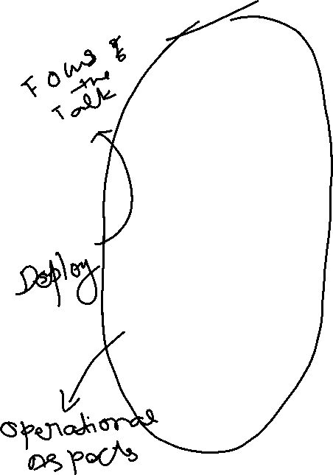
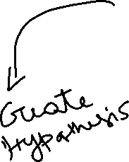
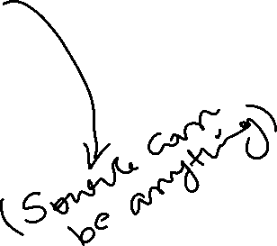
Modeling Data Science Process
Historical Data
[features + labels]
Future Data
[features only]
Define Objective
Split
Training Data
[features + labels]
Testing Data
[features + labels]
Access and Understand the data
Train Model
[model learns from training data]
Score Model
[model predicts on future data]
*
Score Model
[model predicts on testing data]
Pre-processing
Prediction Results
Evaluate Model
[Compare predicted results and true labels]

Slide 10
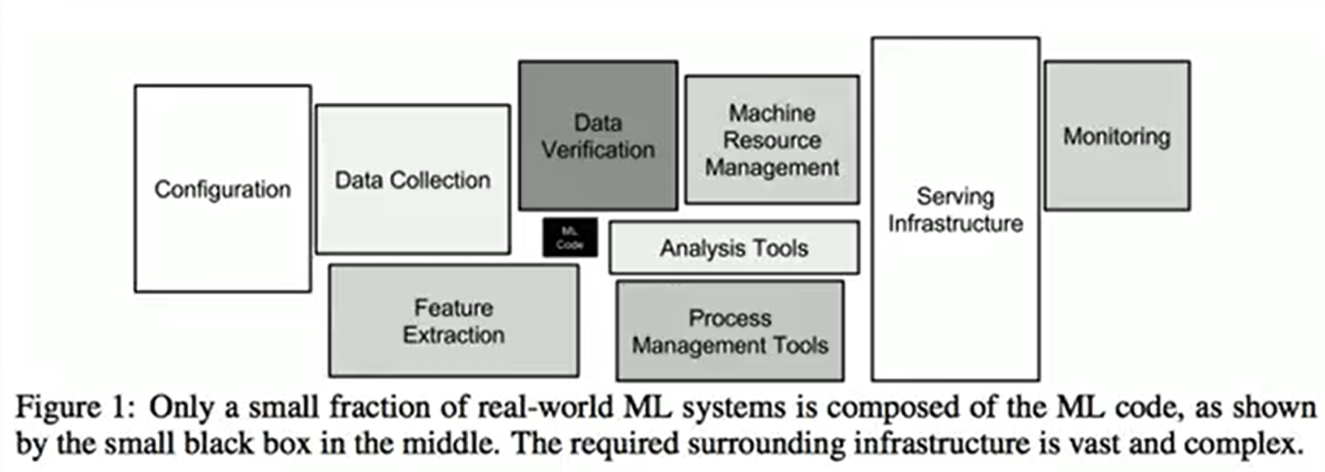
Hidden Technical Debt in ML System
Feedback:
One-line title
Would introduce three buckets similarly to slide 13
Prep and curate
Train and evaluate
Operationalize and manage
One-line title
Take AML out of ML, put it into operationalize and manage
Action:
Update title
Update iconography
Create an option with a process flow
Update layout

Slide 11
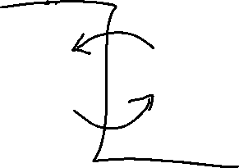
Challenges with Productionizing a Model
Data Science Team
Develop Prototype (Includes Research activities)
Model using Python/R (Mostly on Sample Data)
Data Engineering
Re-implement model for Production (Java, Python)
Additional work
Different Frameworks, code paths and tools
Very tough to implement Agile process Methodologies (like CI and CD etc)
Slow to update Models
Nearly impossible to maintain versioning of Data and Model
Data Science doesn’t translate to production
Spark Structured Streaming
Stream processing

Slide 12
Why do we need Robust Model Deployment System

Slide 13
Different environments where Model gets deployed
Feedback:
One-line title
Would introduce three buckets similarly to slide 13
Prep and curate
Train and evaluate
Operationalize and manage
One-line title
Take AML out of ML, put it into operationalize and manage
Action:
Update title
Update iconography
Create an option with a process flow
Update layout
Web Application / e-commerce portals
Batch Processing Systems / Hadoop / RDBMS (SQL Server)
Real time Processing Systems / Middleware (Biztalk or Service Bus)
Web APIs / Microservices / Modern Infra or Cloud based serverless architecture (Azure Functions)
Embedded in Devices (Mobile Phones, Medical Devices etc.)

Slide 14
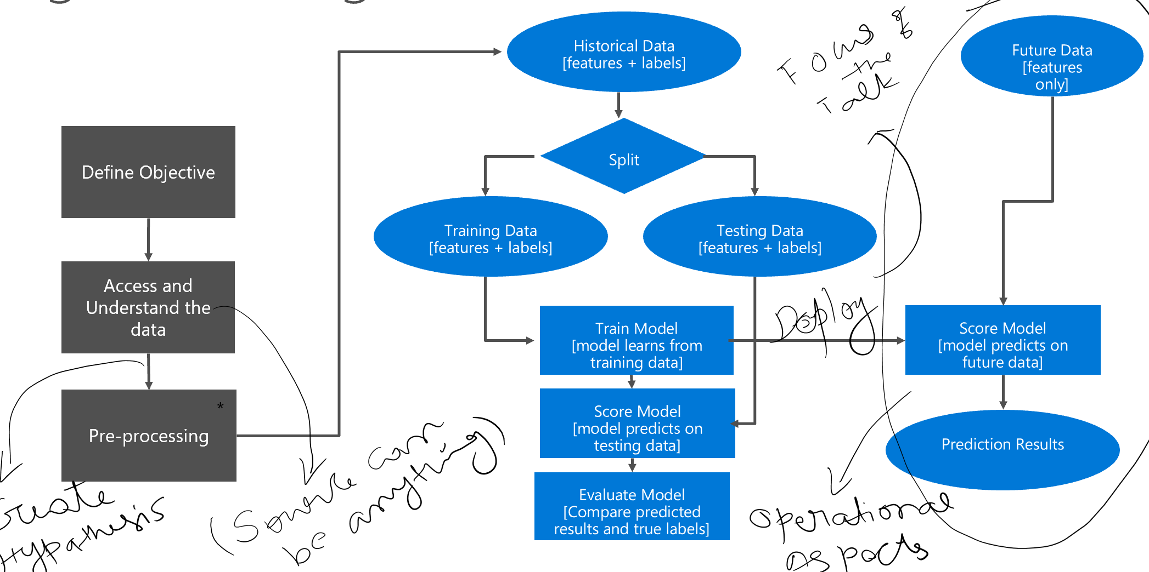
Bring Agile to this process
Deployment Should support A/B testing and experiments
Support Measuring and Evaluating model performance
Entire process should be fast and adaptive

Slide 15
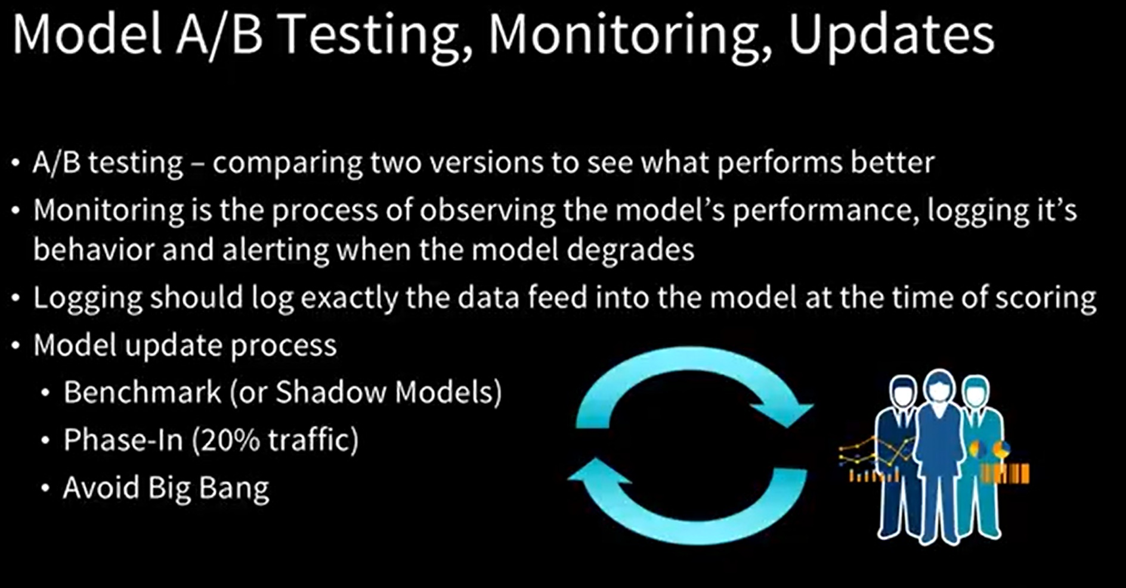
Different environments where Model gets deployed
Feedback:
One-line title
Would introduce three buckets similarly to slide 13
Prep and curate
Train and evaluate
Operationalize and manage
One-line title
Take AML out of ML, put it into operationalize and manage
Action:
Update title
Update iconography
Create an option with a process flow
Update layout
Notes:
Always remember, your algorithm or code never breaks in the ML world, it is data which will break the model. So Logging the data feed is very important.
Shadow Models are set up like Pre-Prod Environment.

Slide 16
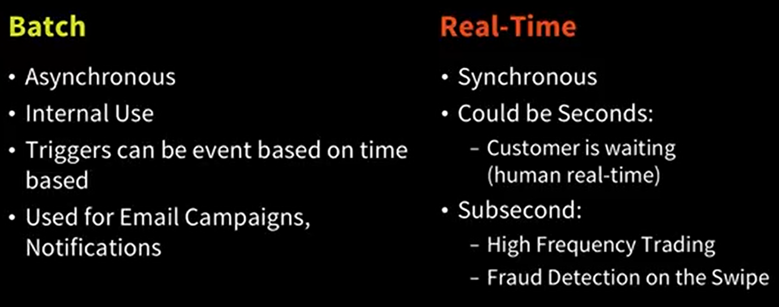
Ideal Scoring Environment
SLAs to Consider
Response Time
Throughput (predictions per second)
Uptime / Reliability
Technology Stack
C/C++
Legacy (Mainframe)
Java/C#
Spark Structured Streaming
Stream processing

Slide 17
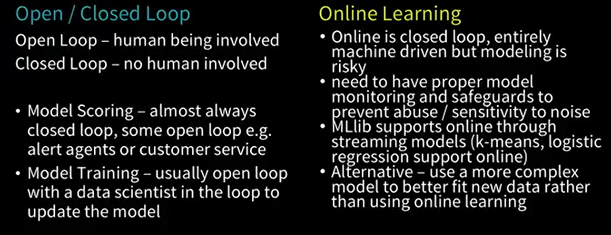
Online Learning and Open/Closed Loop
Spark Structured Streaming
Stream processing

Slide 18
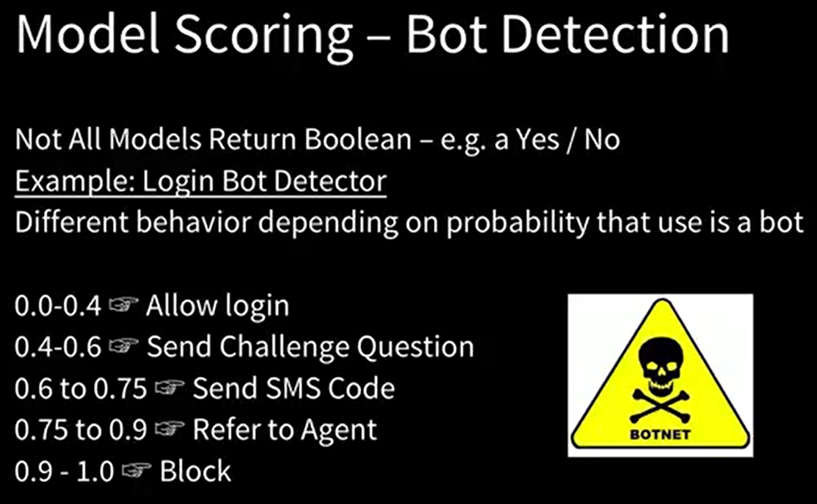
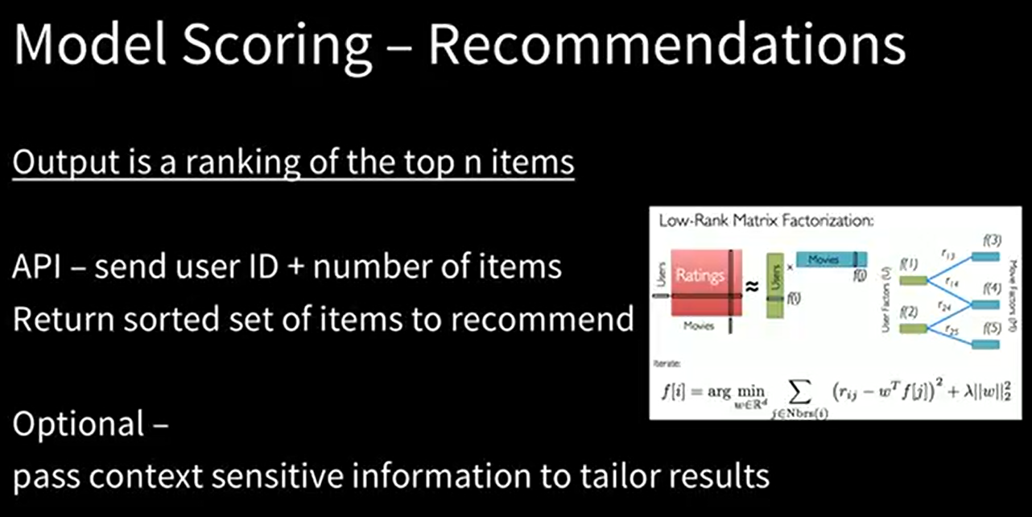
Model Scoring use cases
Spark Structured Streaming
Stream processing

Slide 19
Architecture Options – Model Scoring

Slide 20
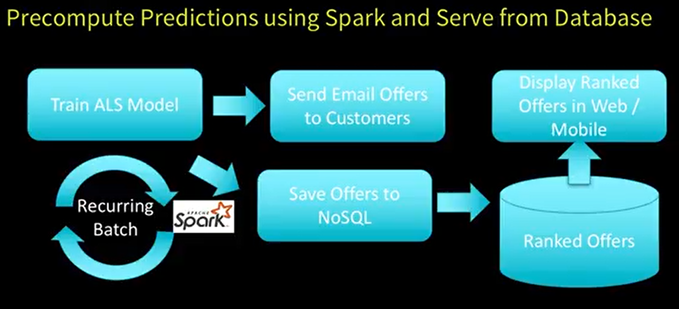
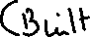
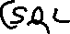
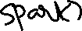
Architecture Sample 1 – eCommerce App
Spark Structured Streaming
Stream processing

Slide 21
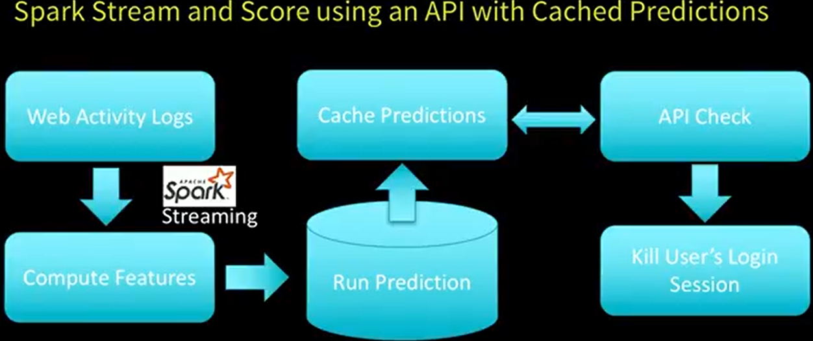
Architecture Sample 2 – eCommerce App
Spark Structured Streaming
Stream processing

Slide 22
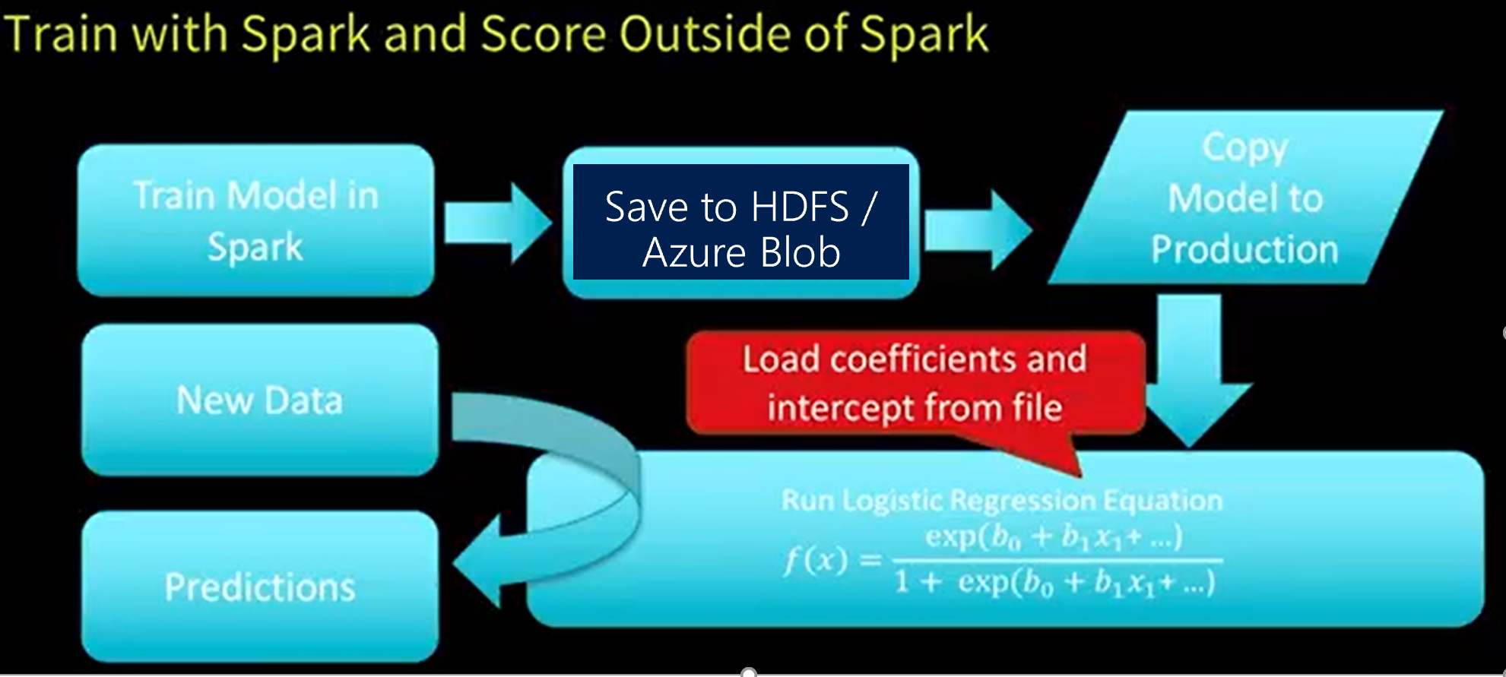
Architecture Sample 3 – Focus of the topic
Spark Structured Streaming
Stream processing

Slide 23
Azure Databricks – ML Model Export

Slide 24
Azure Databricks Model Deployment Life Cycle
Feedback:
One-line title
Would introduce three buckets similarly to slide 13
Prep and curate
Train and evaluate
Operationalize and manage
One-line title
Take AML out of ML, put it into operationalize and manage
Action:
Update title
Update iconography
Create an option with a process flow
Update layout
Fit an ML Model using Apache Spark MLLib
Export the Model into HDFS/Azure Blob Store
Import the model into an external system

Slide 25
Azure Databricks Model Deployment Options
Feedback:
One-line title
Would introduce three buckets similarly to slide 13
Prep and curate
Train and evaluate
Operationalize and manage
One-line title
Take AML out of ML, put it into operationalize and manage
Action:
Update title
Update iconography
Create an option with a process flow
Update layout
MLeap
Open sourced, Easily reuse models with serialization and executing without Spark Dependency.
Databricks ML Model Export
Consistency with Mllib
It supports serializing Apache Spark, scikit-learn, and TensorFlow pipelines into a bundle, so you can load and deploy your trained models to make predictions with new data.
Both Spark Dependency and Non-Spark Dependency

Slide 26
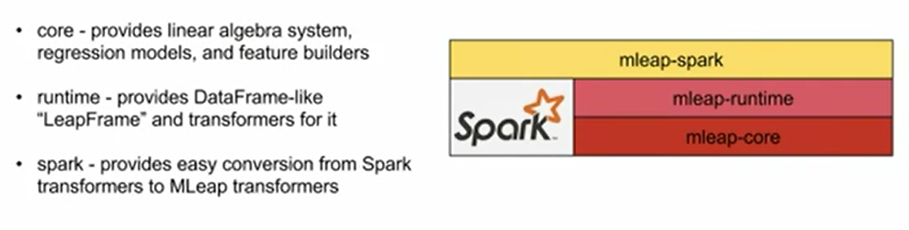
Mleap Components
Feedback:
One-line title
Would introduce three buckets similarly to slide 13
Prep and curate
Train and evaluate
Operationalize and manage
One-line title
Take AML out of ML, put it into operationalize and manage
Action:
Update title
Update iconography
Create an option with a process flow
Update layout

Slide 27
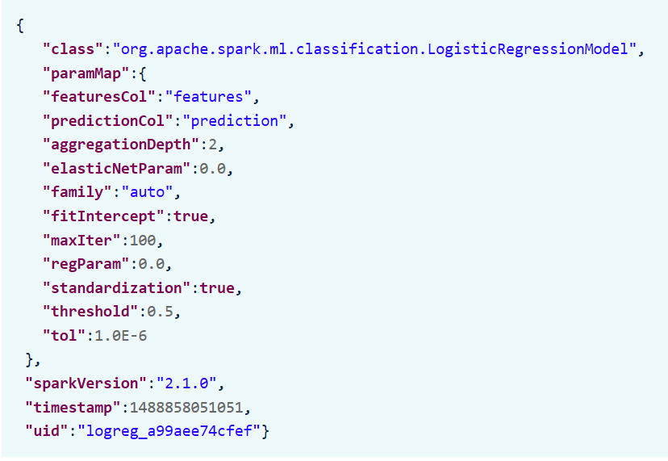
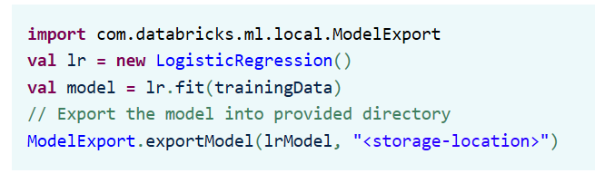
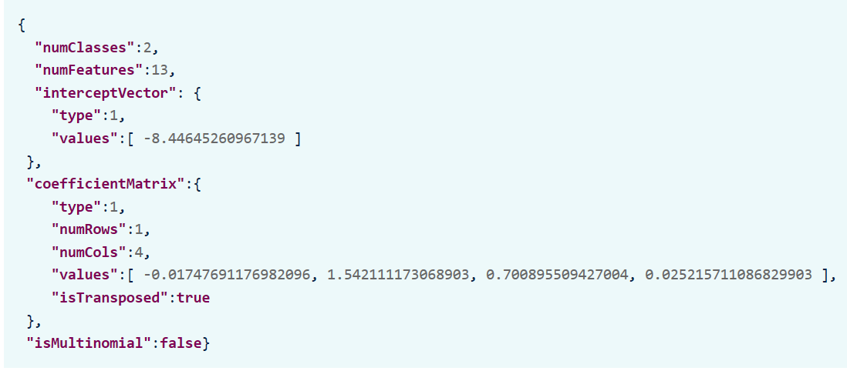
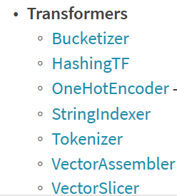
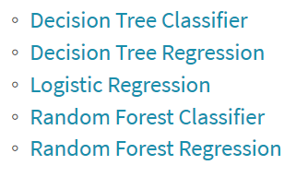
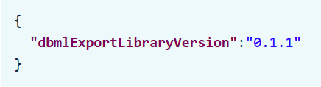
Azure Databricks - ML Model Exporter
Feedback:
One-line title
Would introduce three buckets similarly to slide 13
Prep and curate
Train and evaluate
Operationalize and manage
One-line title
Take AML out of ML, put it into operationalize and manage
Action:
Update title
Update iconography
Create an option with a process flow
Update layout
Code Snippet to Export
>")
Model Export Format
JSON which is very similar to Mleap and even PMMI is JSON format
Supported Models:

Slide 28
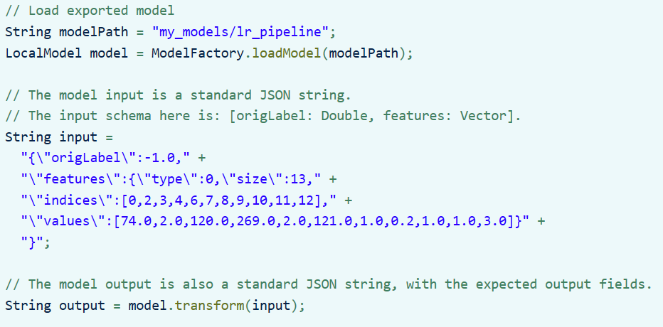
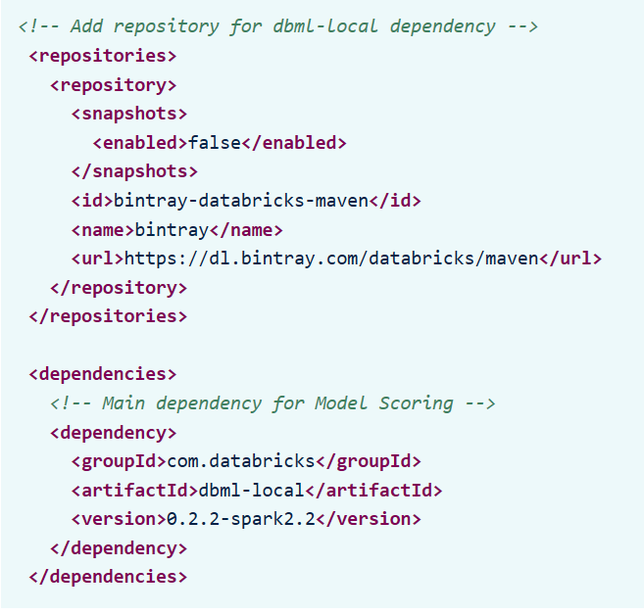
Azure Databricks - ML Model Importing to Application Layer
Feedback:
One-line title
Would introduce three buckets similarly to slide 13
Prep and curate
Train and evaluate
Operationalize and manage
One-line title
Take AML out of ML, put it into operationalize and manage
Action:
Update title
Update iconography
Create an option with a process flow
Update layout
Code Snippet to Import to App
>")
Maven Dependencies

Slide 29
What are these customers looking to do next?
Deep neural networks will be a standard component in 80% of data scientists’ tool boxes
20% of companies will dedicate workers to monitor and guide neural networks
Data scientists will no longer need to manage infrastructure or implement custom code – the systems will scale for them
2018
2019
2020
2021
2022
More than 40% of data science tasks will be automated, resulting in increased productivity and broader usage by citizen data scientists
More than half of global enterprises already using cloud today will adopt an all-in cloud strategy
Notes:
What’s the next best thing?
Taking the analytics piece and expanding that further.
I’m analyzing all of the data I have today (traditionally)
Now, I want to process images, videos (DL), and have intelligent agents and bots (AI)

Slide 30
Questions?

